Slide 1
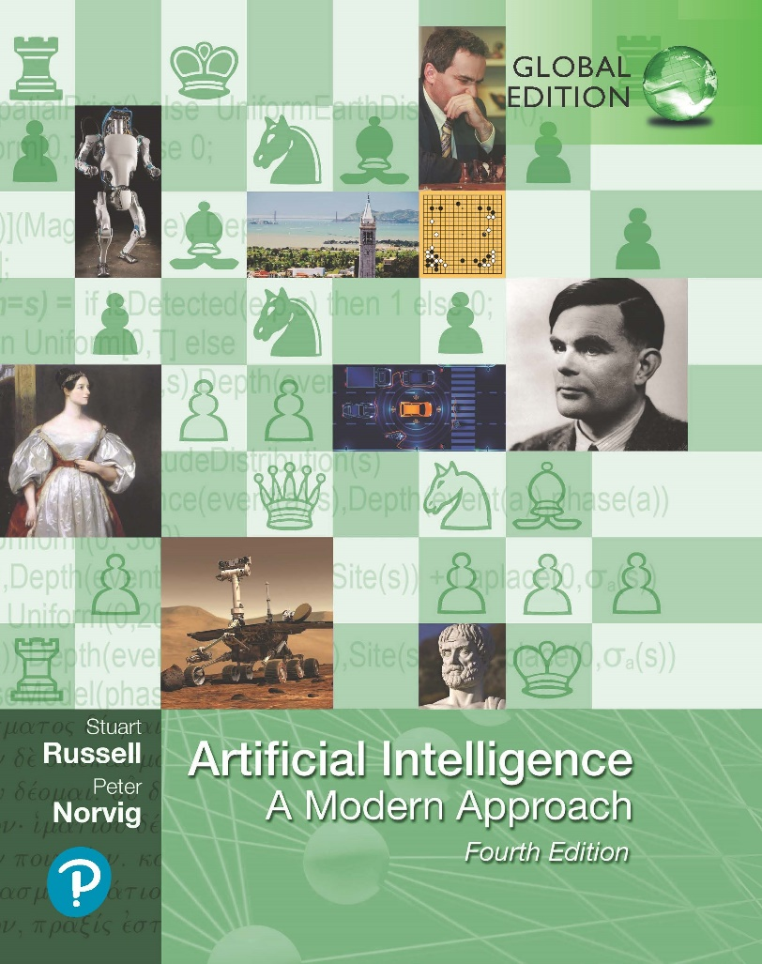
Artificial Intelligence: A Modern Approach
Fourth Edition, Global Edition
Chapter 15
Making Simple Decisions
© 2022 Pearson Education Ltd.

Slide 2
Outline
Combining Beliefs and Desires under Uncertainty Utilities
The Basis of Utility Theory
Utility Functions
Multiattribute Utility Functions
Decision networks
Value of information
Unknown Preferences
© 2022 Pearson Education Ltd.

Slide 3
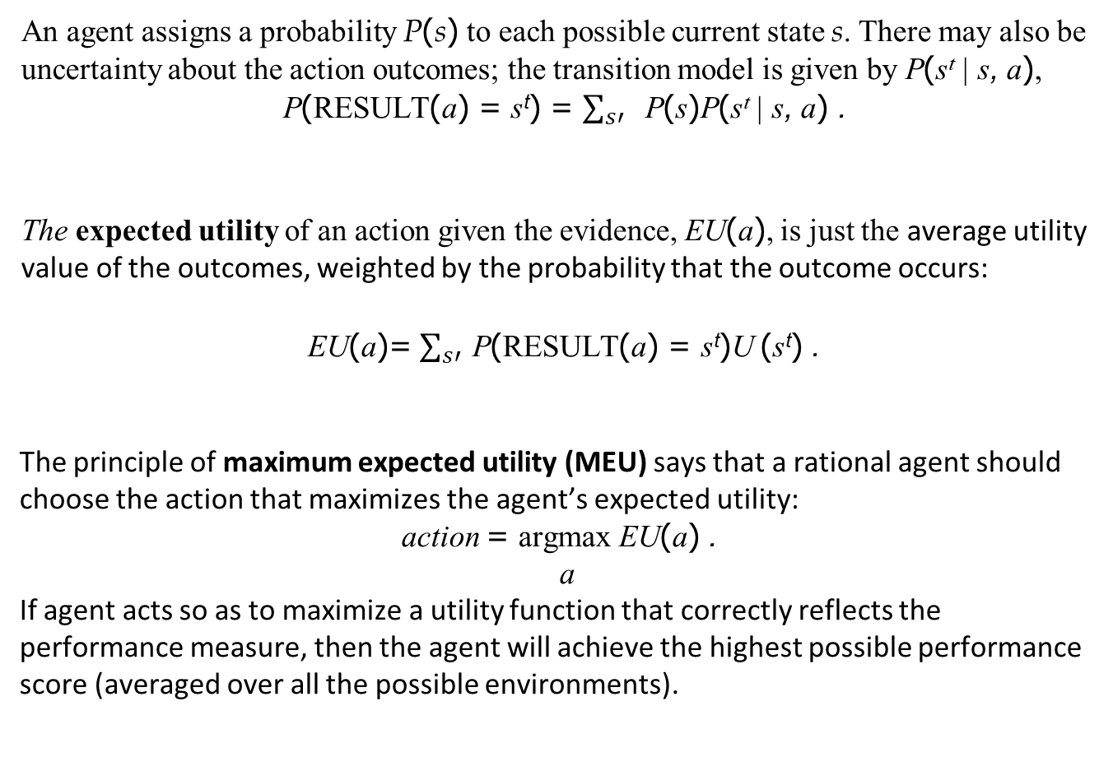
Combining Beliefs and Desires under Uncertainty
An agent assigns a probability P(s) to each possible current state s. There may also be uncertainty about the action outcomes; the transition model is given by P(s^{t} | s, a),
P(RESULT(a) = s^{t}) = $\sum_{s′}{ }$ P(s)P(s^{t} | s, a) .
The expected utility of an action given the evidence, EU(a), is just the average utility value of the outcomes, weighted by the probability that the outcome occurs:
EU(a)= $\sum_{s′}{ }$P(RESULT(a) = s^{t})U (s^{t}) .
The principle of maximum expected utility (MEU) says that a rational agent should choose the action that maximizes the agent’s expected utility:
action = argmax EU(a) .
a
If agent acts so as to maximize a utility function that correctly reflects the performance measure, then the agent will achieve the highest possible performance score (averaged over all the possible environments).
© 2022 Pearson Education Ltd.

Slide 4
The Basis of Utility Theory
Constraints on rational preferences
An agent chooses among prizes (A, B, etc.) and lotteries, i.e., situations with uncertain prizes
A
p
L
1−p
Lottery L = [p, A; (1 − p), B]
Notation:
B
A <; B
A preferred to B
indifference between A and B B not preferred to A
A ∼<; B
A ∼ B
© 2022 Pearson Education Ltd.

Slide 5
Rational preferences
Idea: preferences of a rational agent must obey constraints.
Rational preferences ⇒
behavior describable as maximization of expected utility
Constraints:
Orderability
(A <; B) ∨ (B <; A) ∨ (A ∼ B)
Transitivity
(A <; B) ∧ (B <; C) ⇒ (A <; C)
Continuity
A <; B <; C ⇒ ∃ p [p, A; 1 − p, C] ∼ B
Substitutability
A ∼ B ⇒ [p, A; 1 − p, C] ∼ [p, B; 1 − p, C]
Monotonicity
A <; B ⇒ (p ≥ q ⇔ [p, A; 1 − p, B] <;∼ [q, A; 1 − q, B])
© 2022 Pearson Education Ltd.

Slide 6
Rational preferences contd.
Violating the constraints leads to self-evident irrationality
For example: an agent with intransitive preferences can be induced to give away all its money
If B <; C, then an agent who has C
A
would pay (say) 1 cent to get B
1c
1c
If A <; B, then an agent who has B
would pay (say) 1 cent to get A
B
C
If C <; A, then an agent who has A
would pay (say) 1 cent to get C
1c
© 2022 Pearson Education Ltd.

Slide 7
Maximizing expected utility
Theorem (Ramsey, 1931; von Neumann and Morgenstern, 1944):
Given preferences satisfying the constraints there exists a real-valued function U such that
U (A) ≥ U (B) ⇔ A <;∼ B
U ([p₁, S₁; . . . ; p_{n}, S_{n}]) = Σ_{i} p_{i}U (S_{i})
MEU principle:
Choose the action that maximizes expected utility
Note: an agent can be entirely rational (consistent with MEU) without ever representing or manipulating utilities and probabilities
E.g., a lookup table for perfect tictactoe
© 2022 Pearson Education Ltd.

Slide 8
Utility Functions
Utilities map states to real numbers. Which numbers?
Standard approach to assessment of human utilities:
compare a given state A to a standard lottery L_{p} that has “best possible prize” u_{T} with probability p
“worst possible catastrophe” u⊥ with probability (1 − p)
adjust lottery probability p until A ∼ L_{p}
0.999999
continue as before
pay $30
~
L
0.000001
instant death
© 2022 Pearson Education Ltd.

Slide 9
Utility scales
Normalized utilities: u_{T} = 1.0, u⊥ = 0.0
Micromorts: one-millionth chance of death
useful for Russian roulette, paying to reduce product risks, etc.
QALYs: quality-adjusted life years
useful for medical decisions involving substantial risk
Note: behavior is invariant w.r.t. +ve linear transformation
U ^{t}(x) = k₁U (x) + k₂ where k₁ > 0
With deterministic prizes only (no lottery choices), only ordinal utility can be determined, i.e., total order on prizes
© 2022 Pearson Education Ltd.

Slide 10
Money
Money does not behave as a utility function
Given a lottery L with expected monetary value EMV (L), usually U (L) < U (EMV (L)), i.e., people are risk-averse
Utility curve: for what probability p am I indifferent between a prize x and a lottery [p, $M ; (1 − p), $0] for large M ?
Typical empirical data, extrapolated with risk-prone behavior:
+U
o
o
_{o} o o o
o o
o
o
+$
_{o} o
−150,000
o
800,000
o
o
© 2022 Pearson Education Ltd.

Slide 11
Multiattribute Utility Functions
How can we handle utility functions of many variables X₁ . . . X_{n}? E.g., what is U (Deaths, N oise, Cost)?
How can complex utility functions be assessed from preference behaviour?
Idea 1: identify conditions under which decisions can be made without com- plete identification of U (x₁, . . . , x_{n})
Idea 2: identify various types of independence in preferences and derive consequent canonical forms for U (x₁, . . . , x_{n})
© 2022 Pearson Education Ltd.

Slide 12

Strict dominance
Typically define attributes such that U is monotonic in each
Strict dominance: choice B strictly dominates choice A iff
∀ i X_{i}(B) ≥ X_{i}(A) (and hence U (B) ≥ U (A))
X₂
This region dominates
X₂
A
B
C
B
C
A
A
D
X₁
X₁
Deterministic attributes
Uncertain attributes
Strict dominance seldom holds in practice
© 2022 Pearson Education Ltd.

Slide 13
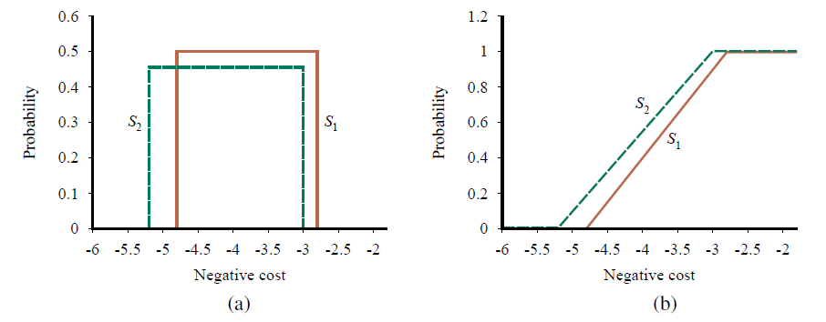
Stochastic dominance
Distribution p₁ stochastically dominates distribution p₂ iff
_{t}
t
∀ t p (x)dx ≤
p₂(t)dt
1
−∞ −∞
If U is monotonic in x, then A₁ with outcome distribution p₁
stochastically dominates A₂ with outcome distribution p₂:
₋∞ p₁(x)U (x)dx ≥ ₋∞ p₂(x)U (x)dx
Multiattri∞bute case: stochastic∞dominance on all attributes ⇒ optimal
© 2022 Pearson Education Ltd.

Slide 14
Stochastic dominance contd.
Stochastic dominance can often be determined without exact distributions using qualitative reasoning
E.g., construction cost increases with distance from city
S₁ is closer to the city than S₂
⇒ S₁ stochastically dominates S₂ on cost
E.g., injury increases with collision speed
Can annotate belief networks with stochastic dominance information:
X −⁺→ Y (X positively influences Y ) means that For every value z of Y ’s other parents Z
∀ x₁, x₂ x₁ ≥ x₂ ⇒ P(Y |x₁, z) stochastically dominates P(Y |x₂, z)
© 2022 Pearson Education Ltd.

Slide 15
Preference structure: Deterministic
X₁ and X₂ preferentially independent of X₃ iff preference between (x₁, x₂, x₃) and (x^{t}₁, x^{t}₂, x₃) does not depend on x₃
E.g., (N oise, Cost, Saf ety):
(20,000 suffer, $4.6 billion, 0.06 deaths/mpm) vs.
(70,000 suffer, $4.2 billion, 0.06 deaths/mpm)
Theorem (Leontief, 1947): if every pair of attributes is P.I. of its com- plement, then every subset of attributes is P.I of its complement: mutual P.I..
Theorem (Debreu, 1960): mutual P.I. ⇒ ∃ additive value function:
V (S) = Σ_{i}V_{i}(X_{i}(S))
Hence assess n single-attribute functions; often a good approximation
© 2022 Pearson Education Ltd.

Slide 16
Preference structure: Stochastic
Need to consider preferences over lotteries:
X is utility-independent of Y iff
preferences over lotteries in X do not depend on y
Mutual U.I.: each subset is U.I of its complement
⇒ ∃ multiplicative utility function:
U = k₁U₁ + k₂U₂ + k₃U₃
+ k₁k₂U₁U₂ + k₂k₃U₂U₃ + k₃k₁U₃U₁
+ k₁k₂k₃U₁U₂U₃
Routine procedures and software packages for generating preference tests to identify various canonical families of utility functions
© 2022 Pearson Education Ltd.

Slide 17
Decision networks
Decision network represents information about the agent’s current state, its possible actions, the state that will result from the agent’s action, and the utility of that state.
Three types of nodes used:
Chance nodes (ovals): random variables, just as they do in Bayesian networks
Decision nodes (rectangles): points where the decision maker has a choice of actions
Utility nodes (diamonds): agent’s utility function.

Slide 18
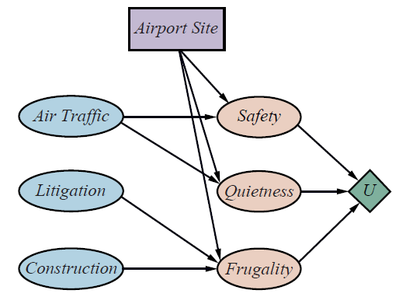
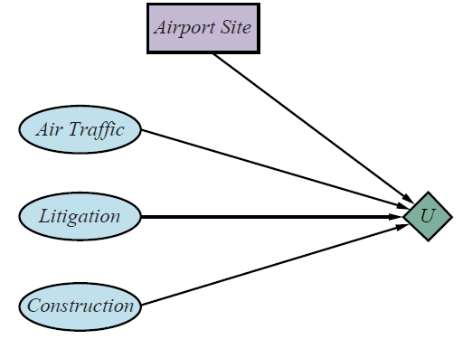
Decision networks
A decision network for the airport-siting problem.
A simplified representation of the airport-siting problem. Chance nodes corresponding
to outcome states have been factored out.

Slide 19
Decision networks
The algorithm for evaluating decision networks is the following
Set the evidence variables for the current state.
2. For each possible value of the decision node:
(a) Set the decision node to that value.
(b) Calculate the posterior probabilities for the parent nodes of the utility node, using a standard probabilistic inference algorithm.
(c) Calculate the resulting utility for the action.
3. Return the action with the highest utility.

Slide 20
The Value of information
Idea: compute value of acquiring each possible piece of evidence Can be done directly from decision network
Example: buying oil drilling rights
Two blocks A and B, exactly one has oil, worth k Prior probabilities 0.5 each, mutually exclusive Current price of each block is k/2
“Consultant” offers accurate survey of A. Fair price?
Solution: compute expected value of information
= expected value of best action given the information minus expected value of best action without information
Survey may say “oil in A” or “no oil in A”, prob. 0.5 each (given!)
= [0.5 × value of “buy A” given “oil in A”
+ 0.5 × value of “buy B” given “no oil in A”]
– 0
= (0.5 × k/2) + (0.5 × k/2) − 0 = k/2
© 2022 Pearson Education Ltd.

Slide 21
General formula
Current evidence E, current best action α
Possible action outcomes S_{i}, potential new evidence E_{j}
EU (α|E) = m_{a}ax Σ_{i} U (S_{i}) P (S_{i}|E, a)
Suppose we knew E_{j} = e_{jk}, then we would choose α_{ejk} s.t.
EU (α_{ejk} |E, E_{j} = e_{jk}) = m_{a}ax Σ_{i} U (S_{i}) P (S_{i}|E, a, E_{j} = e_{jk}) E_{j} is a random variable whose value is currently unknown
⇒ must compute expected gain over all possible values:
V PI_{E} (E_{j}) = Σ_{k} P (E_{j} = e_{jk}|E)EU (α_{ejk} |E, E_{j} = e_{jk}) − EU (α|E)
(VPI = value of perfect information)
© 2022 Pearson Education Ltd.

Slide 22
Properties of VPI
Nonnegative—in expectation, not post hoc
∀ j, E V PI_{E} (E_{j}) ≥ 0
Nonadditive—consider, e.g., obtaining E_{j} twice
V PI_{E} (E_{j}, E_{k}) = V PI_{E} (E_{j}) + V PI_{E} (E_{k})
Order-independent
V PI_{E} (E_{j}, E_{k}) = V PI_{E} (E_{j}) + V PI_{E,Ej} (E_{k}) = V PI_{E} (E_{k}) + V PI_{E,Ek} (E_{j})
Note: when more than one piece of evidence can be gathered, maximizing VPI for each to select one is not always optimal
⇒ evidence-gathering becomes a sequential decision problem
© 2022 Pearson Education Ltd.

Slide 23
Qualitative behaviors
Choice is obvious, information worth little
Choice is nonobvious, information worth a lot
Choice is nonobvious, information worth little
P ( U | E _{j} )
P ( U | E _{j} )
P ( U | E _{j} )
U
U₂ U₁
(b)
U
U₂ U₁
(c)
U
U₂
U₁
(a)
© 2022 Pearson Education Ltd.

Slide 24
Unknown Preferences
Imagine that you are at an ice-cream shop in Thailand and they have only two flavors left: vanilla and durian. Both cost $2. You know you have a moderate liking for vanilla and you’d be willing to pay up to $3 for a vanilla ice cream on such a hot day, so there is a net gain of $1 for choosing vanilla. On the other hand, you have no idea whether you like durian or not, but you’ve read on Wikipedia that the durian elicits different responses from different people: some find that “it surpasses in flavour all other fruits of the world” while others liken it to “sewage, stale vomit, skunk spray and used surgical swabs.”

Slide 25
Unknown Preferences
let’s say there’s a 50% chance you’ll find it sublime (+$100) and a 50% chance you’ll hate it (-$80 if the taste lingers all afternoon).
We can simply replace the uncertain value of the durian with its expected net gain below however the decision will still not changed.
(0.5 × $100) − (0.5 × $80) − $2 =$8
Rather than saying there is uncertainty about the utility function, we move that uncertainty “into the world,” so to speak. That is, we create a new random variable LikesDurian with prior probabilities of 0.5 for true and false in (c)

Slide 26
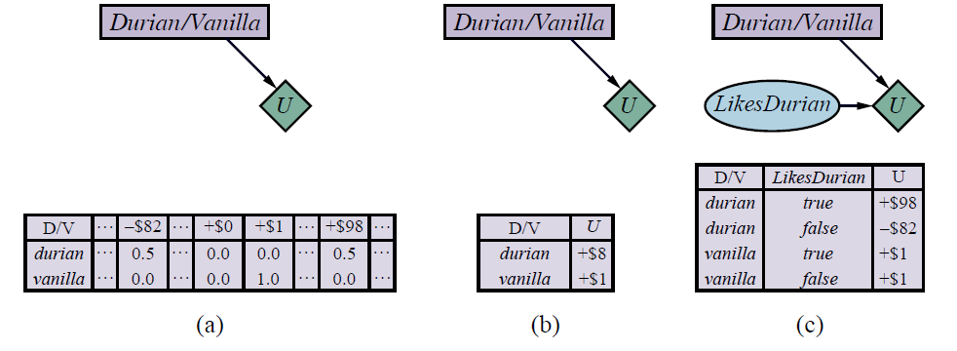
Unknown Preferences
(a) A decision network for the ice cream choice with an uncertain utility function.
(b) The network with the expected utility of each action.
(c) Moving the uncertainty from the utility function into a new random variable

Slide 27
Summary
• Probability theory describes what an agent should believe on the basis of evidence, utility theory describes what an agent wants, and decision theory puts the two together to describe what an agent should do.
• Utility theory shows that an agent whose preferences between lotteries are consistent with a set of simple axioms can be described as possessing a utility function
• Multiattribute utility theory deals with utilities that depend on several distinct attributes of states.
• Stochastic dominance is a particularly useful technique for making unambiguous decisions, even without precise utility values for attributes.
• Decision networks provide a simple formalism for expressing and solving decision problems.
• The value of information is defined as the expected improvement in utility
compared with making a decision without the information

